Slide 1
The Google File System
Alexander Trinh, Fuyao Wang, Zhe Deng,
Geng Song, Zhou Shen

Slide 2

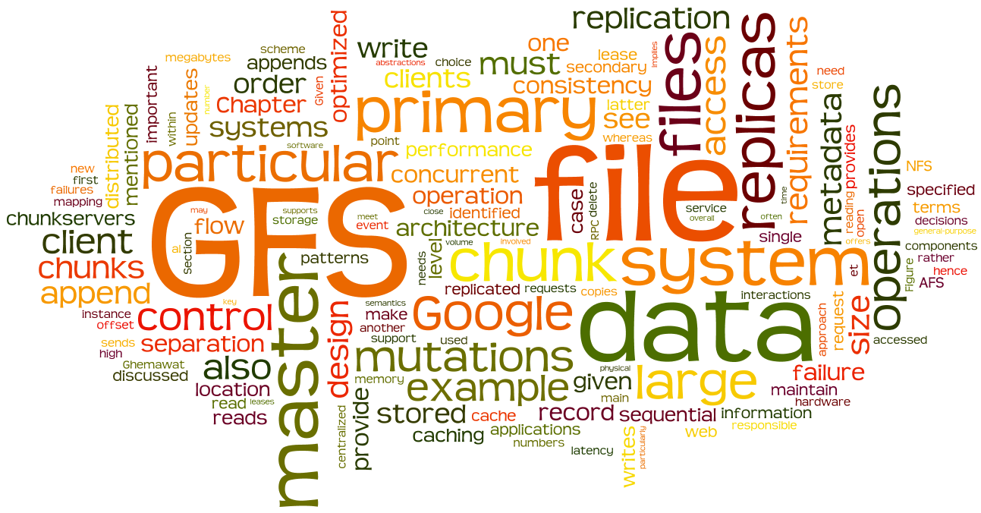

Notes:
I’m sure you guys have all heard of Google
They’re giants in the tech world
Providing millions of users the infrastructure necessary to access and manipulate data
But have you ever thought about the kinds of servers and machines Google requires to upkeep their systems?
Well it’s actually built upon relatively cheap hardware, not crazy expensive and state of the art tech
So, getting into how this happened

Slide 3

Context
Needed a massive storage system to host Google services
MapReduce
Youtube
Search
Large files
Created Google File System (GFS) to solve this storage issue
Notes:
Google at the time was scaling up quickly and needed an efficient file system that their services can leverage
Wanted to integrate within Google to host their services
For example map reduce, youtube, google search, and storing lots of very large files
As a result, they created GFS to solve their storage issues

Slide 4
Google File System
A highly-scalable and distributed file system
Decided to capitalize on off-the-shelve machines
compensated for the unreliability and weaknesses with simplifications and key design choices
Organizes and manages huge files
Allows for users to have sufficient and reliable access to the resources they need
Notes:
So GFS is a highly-scalable and distributed file system
Google had decided to leverage cheap commodity hardware rather than buying much more expensive state of the art hardware
They were already planning to accomodate for machine failure with fault tolerance, so why not buy cheaper hardware
Expensive hardware will also fail sometimes anyways
And because of their scale, they were planning to implement fault tolerance anyways to address the unreliability and weaknesses of the machines
GFS organizes and manages huge files and also grants users the resources they need

Slide 5
Overview
Requirements
Simplifications
Key Design Decisions
Architecture
Special Features
Performance
Impact
Conclusion

Slide 6
Requirements
Needed a file system that operates on a huge scale
Utilize Google’s thousands of cheap hardware
Maintain high availability and consistency even with hardware failures
High performance for writing and reading data sequentially
Notes:
Google had a list of requirements that GFS had to meet
Host their services
Fault tolerance
Failures were the norm
Lots of users, so had to be efficient and have high performance
High performance for writing/reading lots of data sequentially
Read is focused on

Slide 7
Overview
Requirements
Simplifications
Key Design Decisions
Architecture
Special Features
Performance
Impact
Conclusion

Slide 8
Simplifying with Assumptions
Assumptions simplify implementation
No POSIX
Bandwidth Optimized
Bogus data
Expected Workload
Notes:
1.
No timestamps or unuseful metadata
2.
Large files for bandwidth
do not benefit from cache (little spatial locality)
Therefore no need to worry about cache consistency between client and server, less things to worry about
3.
Tolerate commodity hardware
Padding/duplicates allow GFS to meet certain success guarantees:
Appends are aligned with memory blocks
Retries are ok
Allows GFS to achieve its consistency needs while still keeping its architecture
4.
More reads than writes (write once read many times)
Most writes are concurrent appends (atomic appends via record append)
Quick saving of state (snapshot)
Operations are typically sequential and in batch

Slide 9
Overview
Requirements
Simplifications
Key Design Decisions
Architecture
Special Features
Performance
Impact
Conclusion

Slide 10
Fundamental Design Decisions
Triple replication
Single master
Massive block size
Notes:
A bunch of decisions, a few important.
Massive block size: 4KB - 64MB, 64,000 times larger
Triple replication
Single Master

Slide 11
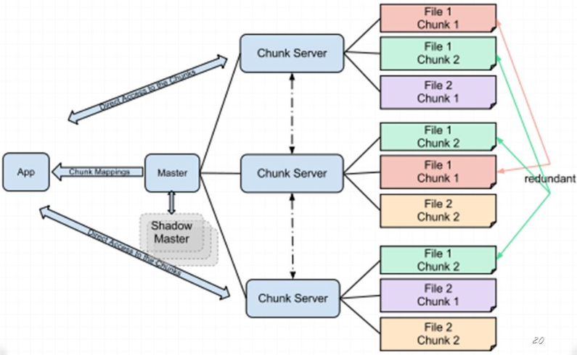
Architecture
Notes:
Zhou’s part. No need for draw, added in animation.

Slide 12
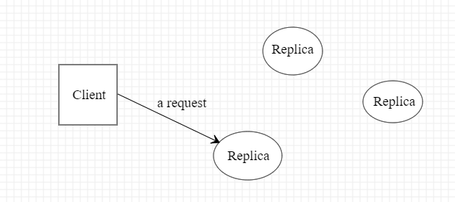
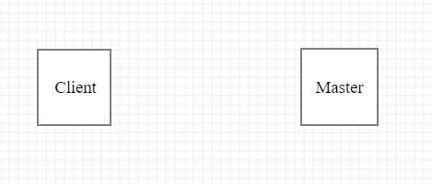
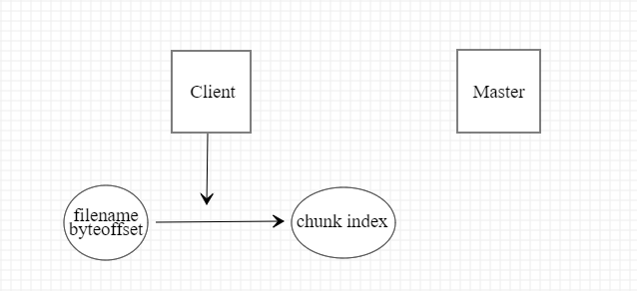
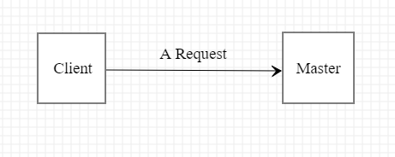
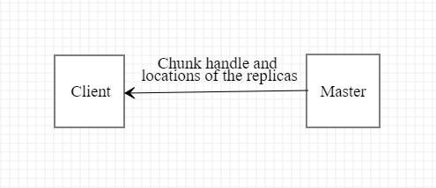
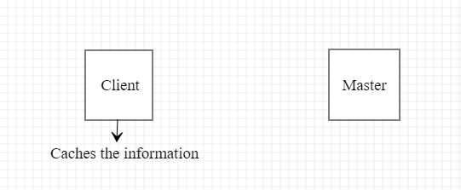
Single Master
5 steps for interactions of a simple read.
Notes:
Zhou. No need for draw, added in animation.

Slide 13
Massive Chunk/Block
Chunk size: 64 MB
This design provides several advantages:
Reduces clients’ needs to interact with the master
Reduces network overhead by keeping a persistent TCP connection
Reduces the size of the metadata stored on the master
Notes:
Zhou’s part.

Slide 14
Overview
Requirements
Simplifications
Key Design Decisions
Architecture
Special Features
Performance
Impact
Conclusion

Slide 15
Architecture
Clients
The term "client" refers to any entity that makes a file request.
Master server
Acts as the coordinator for the cluster.
Chunk servers
The workhorses of the GFS.
Notes:
There are 3 kinds of entities in GFS.
Clients can be other computers or computer applications. You can think of clients as the customers of the GFS.
The master's duties include maintaining an operation log, which keeps track of the activities of the master's cluster. The master server also keeps track of metadata, which is the information that describes chunks.
Chunkservers are responsible for storing the 64-MB file chunks. The chunkservers don't send chunks to the master server. Instead, they send requested chunks directly to the client. The GFS copies every chunk multiple times and stores it on different chunkservers. Each copy is called a replica.

Slide 16
Write
What if we want to write or append?
What if two replicas are written to at the same time?
GFS’s solution: Primary and Secondary Replicas
Eliminates ambiguity in order
Delegating work frees up the master
Notes:
1.
2.
Not consistent. We don’t know which write to keep.
3.
Primaries determined via a lease from the master
Allows the primary to temporary handle operations (usually 1 min, but can be extended)
Typcial setup: 1 primary, 2 chunkservers. Can be changed to meet reliability needs.
4.
Secondaries merely copy the primary
The serial order of the primary determines the ground truth

Slide 17
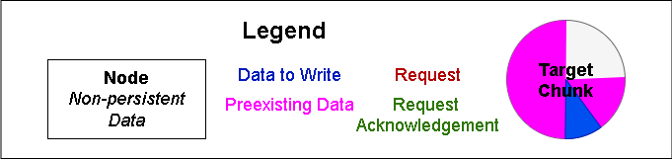
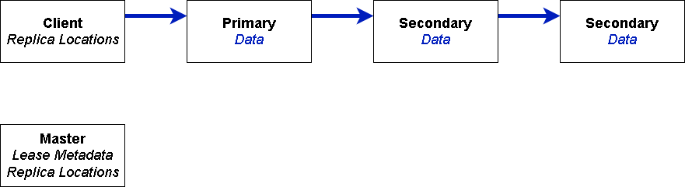
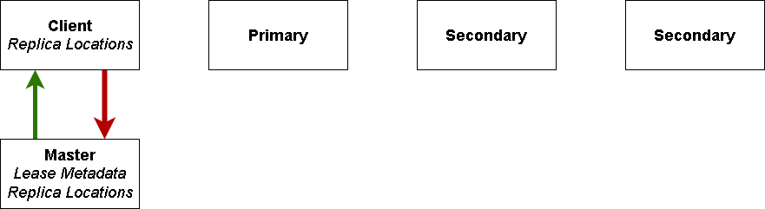
Write
Notes:
Step 1: Client-Master
Client requests locations of chunkservers containing the start of the write
If needed, master determines a primary via a lease and then returns chunkserver locations
This is the only direct master involvement other than on error
Step 2: Client-Chunkserver
Data is pipelined and spreads in series, bandwidth optimized
Step 3: Primary
Primary appends the target chunk in its own serial order
Step 4: Primary-Secondary
Primary forwards request to secondaries
Step 5: Errors
Primary returns errors if any
In case of an error:
Resend data
New replicas

Slide 18
Write
Notes:
Step 1: Client-Master
Client requests locations of chunkservers containing the start of the write
If needed, master determines a primary via a lease and then returns chunkserver locations
This is the only direct master involvement other than on error
Step 2: Client-Chunkserver
Data is pipelined and spreads in series, bandwidth optimized
Step 3: Primary
Primary appends the target chunk in its own serial order
Step 4: Primary-Secondary
Primary forwards request to secondaries
Step 5: Errors
Primary returns errors if any
In case of an error:
Resend data
New replicas

Slide 19
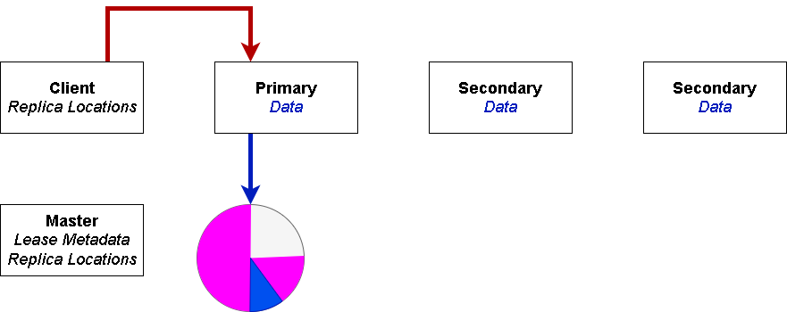
Write
Notes:
Step 1: Client-Master
Client requests locations of chunkservers containing the start of the write
If needed, master determines a primary via a lease and then returns chunkserver locations
This is the only direct master involvement other than on error
Step 2: Client-Chunkserver
Append data spreads to replicas in series
Process is pipelined
Each replica must acknowledge before step 3
Data goes from one node in the chain to the next closest node (Determined via IP), ie data might not go to primary first
No multiplexing, overall time is optimized
Most Important: Pipelined - when a node receives data, it immediately starts sending it to the next node
Client mutations are atomic
Ensures a single correct sequence of chunk mutations
Step 3: Primary
Primary appends the target chunk (e) in its own serial order
Append signal from client
Assigns serial numbers to mutations
the primary decides the order to avoid any confusion
Step 4: Primary-Secondary
Primary forwards request to secondaries
Secondaries append in the same serial order
Primary returns errors if any
In case of an error:
Retry from step 2 (resend data)
Retry from step 1 (new chunkservers)
Important: Consistent behaviour without much master involvement, and also the client
Errors still returned to client, which manages future actions

Slide 20
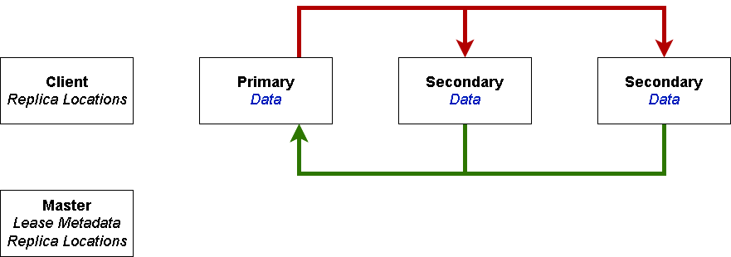
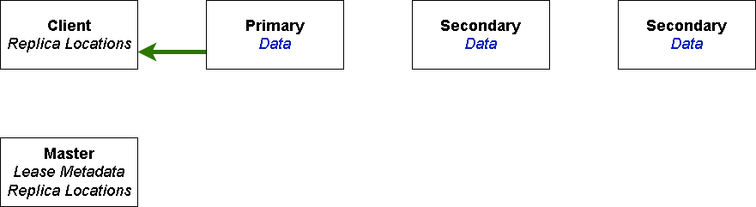
Write
Notes:
Step 1: Client-Master
Client requests locations of chunkservers containing the start of the write
If needed, master determines a primary via a lease and then returns chunkserver locations
This is the only direct master involvement other than on error
Step 2: Client-Chunkserver
Append data spreads to replicas in series
Process is pipelined
Each replica must acknowledge before step 3
Data goes from one node in the chain to the next closest node (Determined via IP), ie data might not go to primary first
No multiplexing, overall time is optimized
Most Important: Pipelined - when a node receives data, it immediately starts sending it to the next node
Client mutations are atomic
Ensures a single correct sequence of chunk mutations
Step 3: Primary
Primary appends the target chunk (e) in its own serial order
Append signal from client
Assigns serial numbers to mutations
the primary decides the order to avoid any confusion
Step 4: Primary-Secondary
Primary forwards request to secondaries
Secondaries append in the same serial order
Primary returns errors if any
In case of an error:
Retry from step 2 (resend data)
Retry from step 1 (new chunkservers)
Important: Consistent behaviour without much master involvement, and also the client
Errors still returned to client, which manages future actions

Slide 21
Write
Notes:
Step 1: Client-Master
Client requests locations of chunkservers containing the start of the write
If needed, master determines a primary via a lease and then returns chunkserver locations
This is the only direct master involvement other than on error
Step 2: Client-Chunkserver
Append data spreads to replicas in series
Process is pipelined
Each replica must acknowledge before step 3
Data goes from one node in the chain to the next closest node (Determined via IP), ie data might not go to primary first
No multiplexing, overall time is optimized
Most Important: Pipelined - when a node receives data, it immediately starts sending it to the next node
Client mutations are atomic
Ensures a single correct sequence of chunk mutations
Step 3: Primary
Primary appends the target chunk (e) in its own serial order
Append signal from client
Assigns serial numbers to mutations
the primary decides the order to avoid any confusion
Step 4: Primary-Secondary
Primary forwards request to secondaries
Secondaries append in the same serial order
Primary returns errors if any
In case of an error:
Retry from step 2 (resend data)
Retry from step 1 (new chunkservers)
Important: Consistent behaviour without much master involvement, and also the client
Errors still returned to client, which manages future actions

Slide 22
Dealing With Failures
Rereplication
Master tells a chunkserver to copy chunk data from a valid replica
This happens when:
A chunkserver becomes unavailable
A replica has become corrupted
Disk is disabled due to errors
Number of desired replications has increased
Rebalancing
Happens periodically by the master
Master will move around replicas to optimize for disk space and load balancing
Notes:
In the case of chunk failures, GFS implements two measures as a safeguard
The first is rereplication, which is when the master tells a chunkserver to copy chunk data directly from an existing valid replica
This happens when a chunkserver becomes unavailable, if its replica has become corrupted, if its disk is disabled due to errors, or if the desired number of replications has increased
The second is rebalancing
This happens periodically when the master examines the current distribution of replicas
The master will move around the replicas to optimize for disk space and load balancing

Slide 23
Garbage Collection
Wanted to simplify deletion
Traditional eager deletion would have to address the following situations
Chunk replica failure
Leaves replicas transparent to the master
Deletion failures
Master must resend to make sure all replicas are deleted
This would overcomplicate deletion
Master more prone to bottlenecking
No safeguard against user mistakes of deletion
Notes:
There was a design choice to choose lazy deletion over eager deletion
For example if we were to have eager deletion, clients could have more control over how memory is used and manipulated
However, we would need to deal with the following
In the event of a chunk replica failure, there may be a replica which is transparent to the master
In the event of a deletion failure, the master must keep resending until it is actually deleted
Overall, this would overcomplicate design and give up efficiency
The master would be more prone to bottlenecking
And there would also be no safeguard against a case where a user deletes something by mistake

Slide 24
Garbage Collection
Master scans its cluster with HeartBeat messages
HeartBeat messages are regular exchanges between master and chunks
Processes chunkserver’s subset of chunks
Deletes orphaned and inconsistent chunks
Orphaned: unreachable chunks
Inconsistent: not found within master’s metadata
Deletion: proceeds with deletion (in memory metadata is erased)
Notes:
Garbage Collection within GFS is a process where the master routinely scans its cluster
It incorporates this process along with HeartBeat messages
Now HeartBeat messages are regular exchanges between the master and chunks
The master then looks for first orphaned chunks, which are completely unreachable
Next, it looks for inconsistent nodes, which are found by comparing chunkserver’s subset of chunks against the master’s metadata knowledge
If there is a chunk the master does not know about, it is found to be inconsistent and deleted
The master also proceeds with the deletion of files which were asked to be deleted
At this point, they would have to have been hidden for 3 days after the initial request for deletion

Slide 25
Advantages
Much easier to implement with GFS architecture
Able to find all replicas in chunkserver directories
File-chunk mappings held by the master
Fast
Master operations are fast due to metadata being stored in memory
Allows for the scanning of its cluster in the background
Runs HeartBeat messages to communicate and collect data from chunks
Incorporate garbage collection with these heartbeat messages
Notes:
Now why is garbage collection useful?
Well it’s quite easy to implement within GFS
We can find all replicas in chunkserver directories and have file to chunk mappings
This allows for consistency checks between the master and chunkservers
So this helps to keep a massively distributed file system like GFS in check
Also, garbage collection is quite efficient and fast
Master operations are quick because metadata is stored in memory
Allows for the scanning of its cluster in the background
This means that garbage collection only happens when the master is relatively free
So garbage collection usually does not interfere with the master during unideal times
Utilizes HeartBeat messages
So garbage collection was just be implemented within the already in place HeartBeat messages

Slide 26
Overview
Requirements
Simplifications
Key Design Decisions
Architecture
Special Features
Performance
Impact
Conclusion

Slide 27
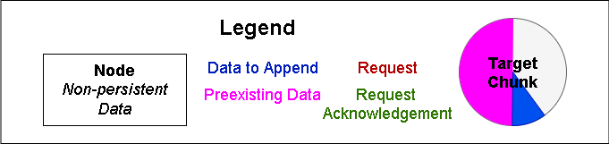
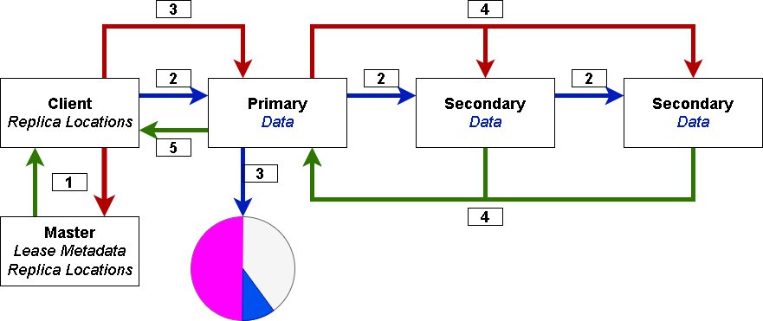
Record Append
Notes:
Why? Consider using write for appends: This involves first seeking to the end of file. Then writing. But GFS’s writes are mostly appends.
Optimize the common case: Atomic appends.
Very similar to a write but with a few extra conditions:
Many clients can append at once
Primary sets order of client appends, this is possible because the appends are atomic
No need for extra locks
What if an append doesn’t fit? Use the assumptions we made (bogus data is ok)
Client can just pad the chunk and request a new set of chunks
Any fragments or junk is tolerated, thus no need for any other action
Most appends are small and the chunkserver is large, so fragmentation is not a big issue and padding is an exception

Slide 28
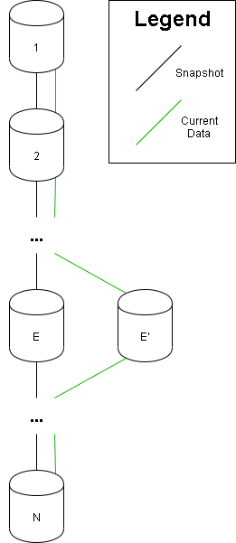
Snapshot
Any writes or record appends to a snapshotted chunk (E) copies the chunk locally on the chunk server (E’) and then applies the mutation
Minimize network usage
Master Recovery
Notes:
1.
We can delete older logs before a snapshot
Can be done on files or entire directories
Implementation for checkpoints or for branching state
2.
Chunk copies on write are done locally ->virtually no cost or added latency
3.
Extra metadata that the master can use to recover the fs state
Snapshot files that point to the source files for Copy on Write use

Slide 29
Overview
Requirements
Simplifications
Key Design Decisions
Architecture
Special Features
Performance
Impact
Conclusion

Slide 30
Performance
Components
One master
Two master replicas
16 chunkservers
16 clients

Slide 31
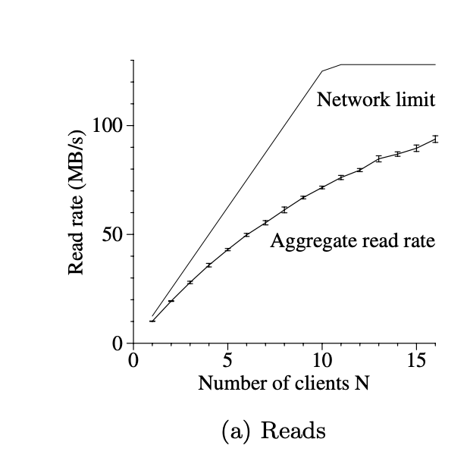
Performance
Reads
Network limit at an aggregate of 125 MB/s
12.5 MB/s per client
Observed aggregate read rate is 94 MB/s
10 MB/s for one client read
9.4 MB/s per client with an enlarging group

Slide 32
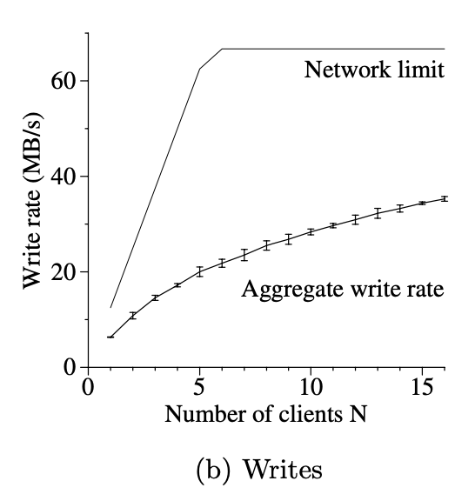
Performance
Writes
Network limite at an aggregate of 67 MB/s
Need to write to three chunkservers
Observed aggregate write rate is 35 MB/s
Multiple clients concurrent write cause collision

Slide 33
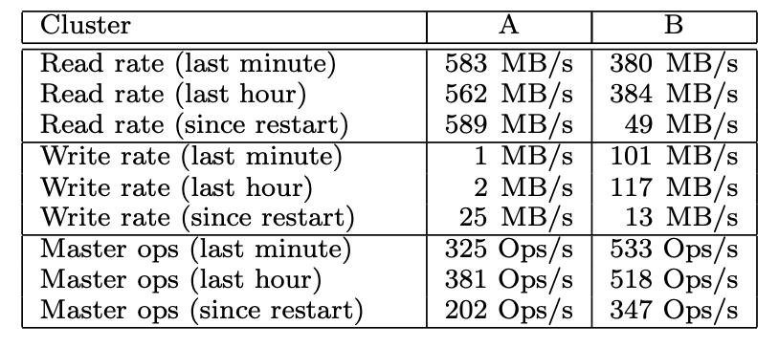
Performance
Cluster A: mainly used for research and development
Cluster B: mainly used for production data processing

Slide 34
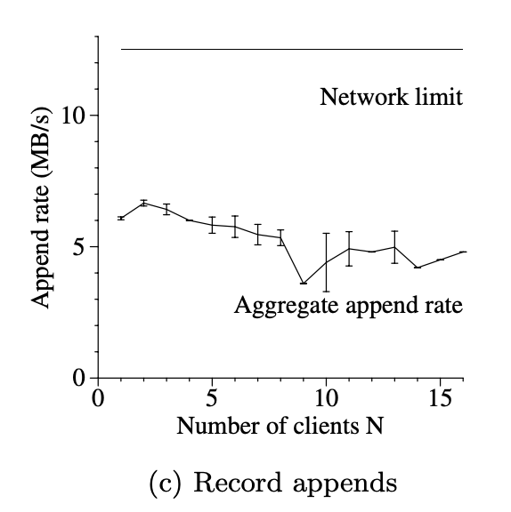
Performance
Record Appends
Performance limited by the network bandwidth of chunkservers
Observed aggregate read rate is 6-4.8 MB/s
Congestion and variances in network transfer

Slide 35
Overview
Requirements
Simplifications
Key Design Decisions
Architecture
Special Features
Performance
Impact
Conclusion

Slide 36
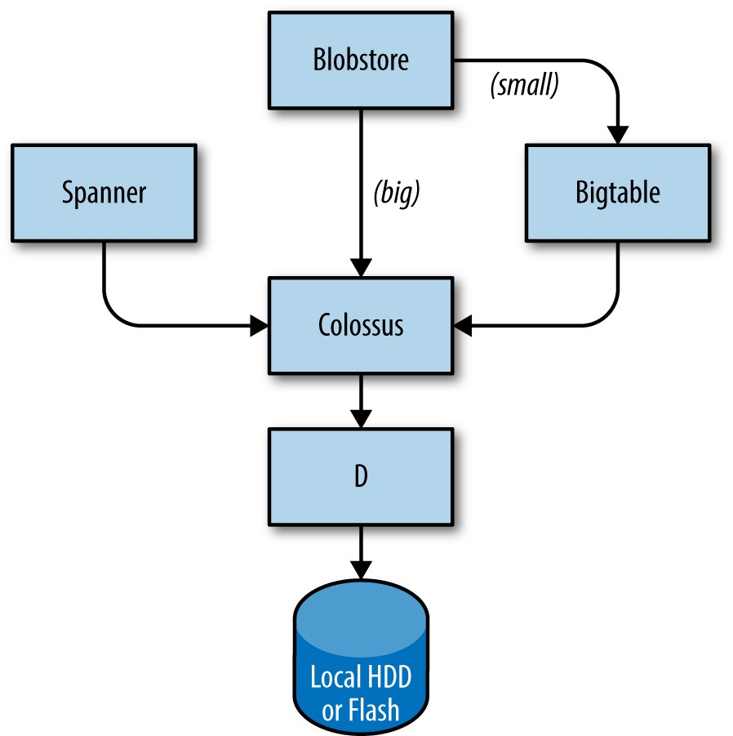
Impact
Success!
Google File System → Colossus
Hadoop Distributed File System
Currently cited 2463 times
Challenged traditional file system paradigms
Notes:
GFS was a huge success
Able to actually leverage their cheap commodity hardware to the fullest and implement it within Google
Was widely deployed within Google and certainly met their needs
The successor of GFS, Colossus is still being used by Google today
Is the backbone to many vital Google services today,
Such as Spanner, Blobstore, and Bigtable
Hadoop Distributed File System (HDFS)
Was inspired by GFS and also incredibly widely used
Borrows the principles of replicating data across multiple server
For example storing data across multiple nodes, where each node has chunks of data
Currently, the GFS paper has been cited over 2000 times, showing how profound their work was in deviating from traditional file systems
So overall, GFS certainly has made a profound impact not only within Google but also in the tech world

Slide 37
Conclusion
GFS is a filesystem for:
Large files
Sequential and concurrent operations
Commodity Hardware
Notes:
1.
64 MB chunks and delegating tasks to chunkservers
Consistency and global operations of a master
Speed of clients talking directly to chunkservers via leases
2.
Record appends are atomic.
High Bandwidth
Ambiguity resolved by the primary
3.
Self-healing (heartbeats)
Heartbeats poll for changes, handles random events that are hard to predict
Keeps the master in touch with replicas (eg lease extension)

